Slide 1

Correlations Between Political Factors and Economic Prosperity
Madison Turano
Data Science MS Students

Slide 2
1: Data and Overview
Data from Human Progress and The World Bank
Economic Prosperity:
Gross Domestic Product (GDP) per person
Gross Domestic Income (GDI) per person
Political Factors
Taxation, Trade Barriers
Legal Structure and Enforcement
Questions: What correlations are there between political factors and economic prosperity?

Slide 3
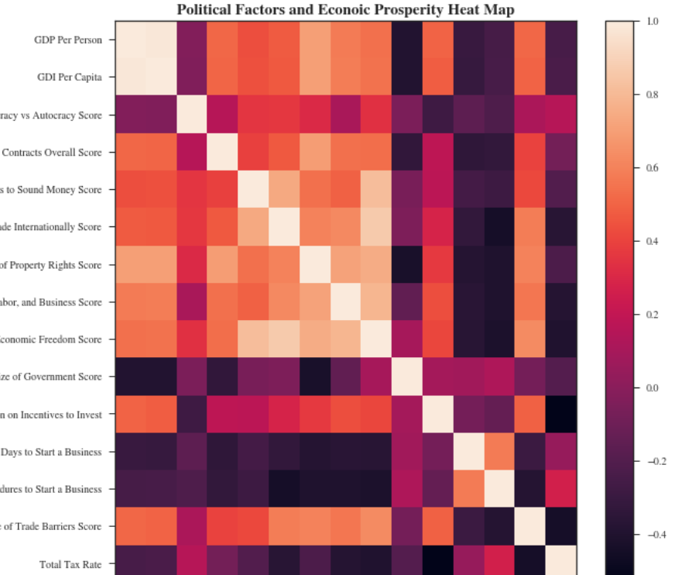
2: Heat Map
High correlations with Enforcing Contracts, Access to Sound Money, Property Rights
Low correlations with Dem. Vs Autocracy, Size of Government, Total Tax Rate

Slide 4
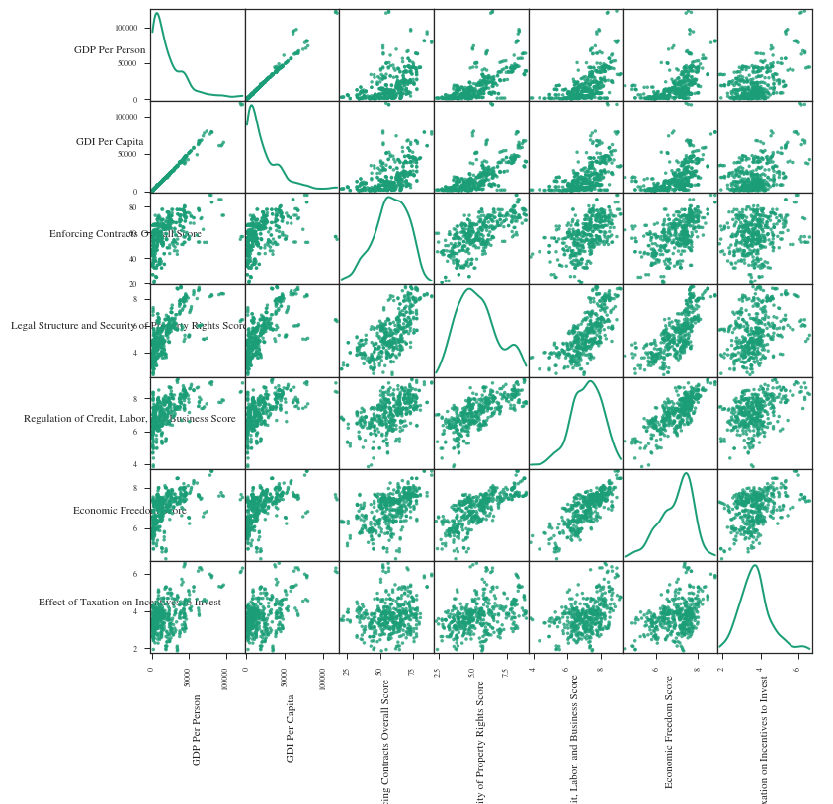
3: SPLOM Scatter Plot
Strongest linearity for GDP is Property Rights
Less with Economic Freedom and Tax Effect on Investment Incentive

Slide 5
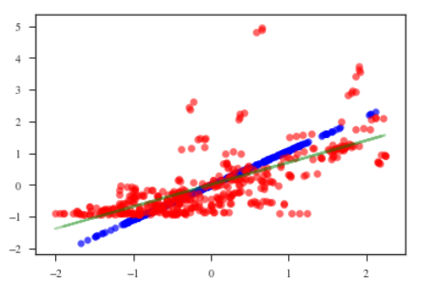
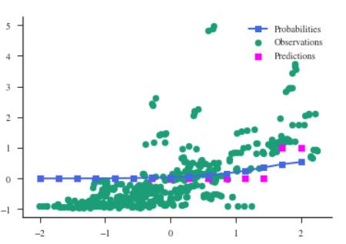
3: Linear Regression
Figure 1
Linear regression modeling using GDP Per Person and Security of Property Rights
Figure 1: Reconstructions of data using linear regression model
Figure 2: Prediction of Probabilities of GDP Per Person based on Property Rights
Figure 2

Slide 6
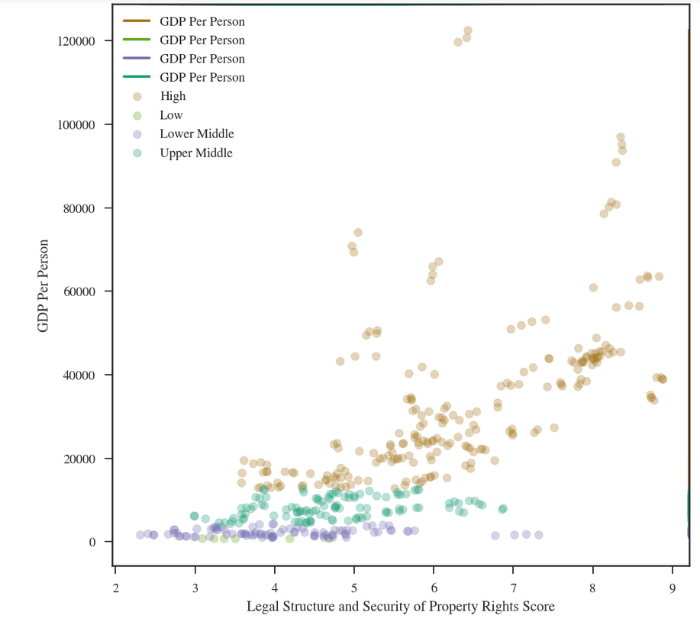
4: Clustering
Clustering by Income Classification

